Slide 1
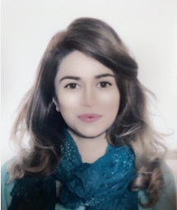
“The only person you are destined to become is the person you decide to be.” Ralph Waldo
M.A Addiction Studies
M.Sc. Applied Psychology
PG Diploma in Special Education Needs
Registered Behaviour Technician (RBT)
International Certified Addiction Counsellor by ICCE
Lubna Altaf

Slide 2

DARA & Mahidol University

Slide 3
Drug & Alcohol Rehab Asia (DARA)
Treatment for all types of addictions
Alcohol Addiction or Alcoholism
Drug Addiction (Marijuana, Cocaine, Heroin & other illicit drugs )
Prescription Drug Addiction (Opioids, CNS Depressants and Stimulants)
Dual Diagnosis

Slide 4

Non 12-Step Treatment Program
vs. Prior Experience Of 12 Step Model

Slide 5
Integrated Cognitive-Behaviour Treatment Model
Clinical Sub-Modalities Include:
Cognitive Behavioural Therapy
Rational Emotive Behaviour Therapy
Schema-focused Therapy
Motivational Interviewing
Psychodynamic Psychotherapy
Solution-focused brief therapy
Art as Therapy

Slide 6
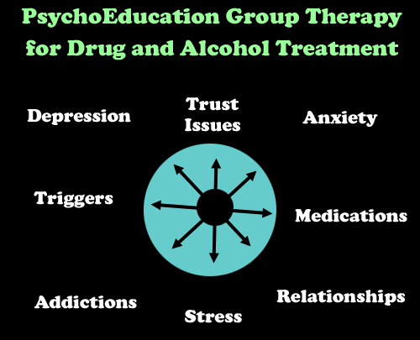
Group Therapy & 1:1 Session

Slide 7

Physical Therapy & Meditation

Slide 8

We Are What a Drug Rehab Center Should Be
“Hardships often prepare ordinary people for an extraordinary destiny.” – C.S. Lewis

Slide 9
Practicum/Internship @ DARA
February – July 2015
Key Responsibilities As Intern
Co-facilitate Groups with senior therapist.
Inducting clients and intake of medical and mental history on arrival and walk them through the entire facility and treatment model.
Conducted risk assessments of new and assigned clients.
Provide introductory CBT individual sessions and conduct Schema analysis of clients.
Co-facilitate in development of treatment plans, process notes, and diagnostic summaries.
Monitoring ongoing performance contracts and strategies coordinating and scheduling all other clinical services to ensure appropriate utilization of continuum of care.

Slide 10
Practicum/Internship @ DARA
February – July 2015
Key Responsibilities As Intern
Performing overnight shifts and On-calls and handling emergency situations and preparing reports.
Managing clients on their weekly excursions and preparing behavioral modification and assessments.
Attended weekly supervision and case conference meetings to assess the progress of the client’s development.
Leading Art therapy sessions and presenting reports on clients behaviors.
Adhering to policies indicative to the standards of confidentiality and safety of the clients.

Slide 11

Thank you ALL!
ICUDDR (The International Consortium of Universities for Drug Demand Reduction)
Addiction Department, ASEAN Institute for Health Development, Mahidol University
DARA (Drug & Alcohol Rehab Asia)

